Slide 1
ATDD – using Java, Cucumber, Jenkins
Virtual DevDays 2017
Listen listening
Mehul Shah, DevOps Engineering/ Coach
Harshit Mehta, Clinical solution/ OCM SDET
DevOps Engineering

Slide 2
Agenda
Why + Poll
What
How (people, process, tools)
Demo/Example
OCM ATDD Implementation
Best practice
Q&A

Slide 3


Separated view and work
QA –
writing test cases/scripts
Testing
Business – PO/BA/SA
Writing requirements
features/user stories
Requirements
Dev –
writing code and unit test
Development

Slide 4
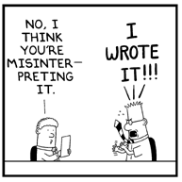
Requirements are Interpreted
Interpretations can be different between business, development and QA.
These can result into missed requirements and/or defects, often late in the cycle, with increased cost to fix.
Can we do anything?

Slide 5
ATDD
Benefits
Problems
Missed Requirements
Defects
EXAMPLES
Automation
collaboration
Feedback
Faster Value Delivery
QA Cycle Time
ATDD
Manual Effort
Reduce Cost
Slow Feedback
Single Source of Truth

Slide 6
ATDD – Benefits
Vanilla Scrum/Agile | With ATDD | Business Value
Emphasis on working software | Additional emphasis on upfront collaboration with DSL - Gherkin | Agile Transformation, value delivery: “Early alignment of team – PO/BA/SA/QA/Dev”
Multiple sources of truth | Single source of truth in CA Agile/Rally or feature file | Quality: “Reduced confusion, and overheads”
Dev to QA handoff | Dev and QA/SDET collaboration [SDET = Software Developer Engineer in Test] | Quality, Speed to market: “Early feedback on application quality”
Manual testing in-sprint or (n-1) sprint | Automated in-sprint testing with continuous integration | Speed to Market, Reduced cost: “Faster and frequent testing in-sprint, reduced overhead”

Slide 7
Shift Left
Test early, test often and test everything:
Integration, Performance, Security, Acceptance
Later the issues are found, more time (& cost) to fix
Use time to deliver value and not fixing defects
Programming defect found via Continuous Integration
Non functional testing immediately prior to production
Design or programming defect found via Test Driven Development (TDD)
Requirements defect found via traditional acceptance testing
Cost
Requirements or design defect found via Active Stakeholder Participation
Requirements and integration defects found via Acceptance Test Driven
Development (ATDD)
Design defect found via traditional system/
integration testing
Programming defect found via traditional QA hand-off testing
Length of Feedback Cycle

Slide 8
Poll

Slide 9
What is ATDD ?
Acceptance Test-Driven Development (ATDD) is a practice where the whole team collaborates in developing acceptance criteria, before development starts
Acceptance criteria are captured in form of examples to demonstrate desired behavior, instead of comprehensive requirements, in a “language” that team/stakeholders understand
Team discusses (business, dev, qa) the requirements/ story by asking what is needed, and then asking, “how will we know we’ve done that?” This becomes acceptance scenarios and the documents of truth
Scenarios are automated and successfully executed to accept user story
Notes:
ATDD Fundamentals (30 mins)
What is ATDD CI
Rollout Plan
Gherkin, XP concepts, Spec. by Example
Test Driven Development and Red, Green, Refactor
Family of gherkin tools for ATDD

Slide 10
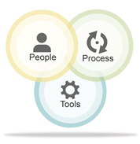
How you do ATDD ?
People | QA to QE/ SDET, Shift in thinking
Process | Collaboration in defining Acceptance Criteria and automation, Continuous Integration, Frequent execution, Training and Coaching
Tools/ Technology | CA Agile central/ Rally, Automation frameworks, Gherkin, Atom editor, Java (other languages), GitHub, Selenium, LeanFT, Cucumber, Jenkins, SauceLabs

Slide 11
ATDD – Three Amigos Collaboration
The up-front collaboration between the product owner/business, developer and tester is crucial in defining specifications.
At minimum three roles create specifications, but the entire team may be present and contribute.
When each of these 3 viewpoints are met, you should find clear specifications that provide value.
PO/Business: gets clarity from end user perspective … happy path and key scenarios at higher level
Tester: gets the clarity from testing perspective… negative scenario, edge cases, errors/exceptions, test logic and test data
Developer: gets clarity from development perspective, contributes with white box view of code and dependencies

Slide 12

Acceptance criteria connects all
Requirements
Business
Requirements for
& specification by example (SbE)
, single source of truth
Requirements
Automated
Test
AC/SbE
Test cases/ scripts for
QA
& executable specification
Living
Documentation
Specifications for
& guides development
Application Code
Dev

Slide 13
SbE to Living Documentation
Business Goal
Derives the scope
Scope / Desires
Specifications that are …
Well organized
Easy to find and access
Consistent
Reliable
Authoritative
Easy to understand
Kept up-to-date
… evolve to become single source of truth and living Documentation!
Specify collaboratively
Key Scenarios / Examples
Shared Understanding
Ubiquitous Language
Refine the specification
Specifications with Examples
Automate literally
Executable Specification
Validate frequently
Living Documentation

Slide 14
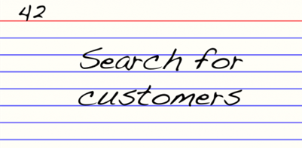
INVEST stories with acceptance criteria
Feature
INVEST Story
#US00168: Search by Name
In order to keep short customer response time
As a customer service representative
I want to search for my customers by their first and last names
Acceptance Criteria: Scenarios
User Story: Search by Name
In order to keep short customer response time
As a customer service representative
I want to search for my customers by their first and last names
Scenario: 1. Combination of first and last name
Scenario: 2. First name only
Scenario: 3. Last name only
Scenario: 4. Blank name
Scenario: 5. Special characters only
Scenario: Gherkin/ Specification by Example
Scenario Outline: 3. Last name only
Given these customers:
| First Name | Last Name |
| Mehul | Shah |
| Burt | Corbin |
| Dana | Thomas |
| Amanda | Prince |
When I search for Last Name of “Corbin"
Then search returns “1" customer with “Burt Corbin”

Slide 15
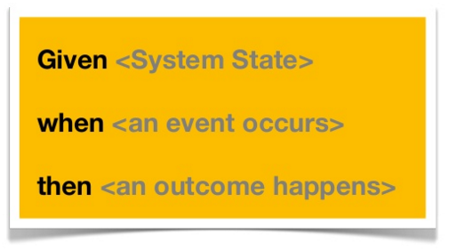
Gherkin - language
Gherkin is a business readable domain specific language.
Line-oriented language
Gherkin is used to write acceptance criteria with keywords:
Feature
Scenario
Given, When, Then, And, But
Background
Scenario Outline
Examples

Slide 16
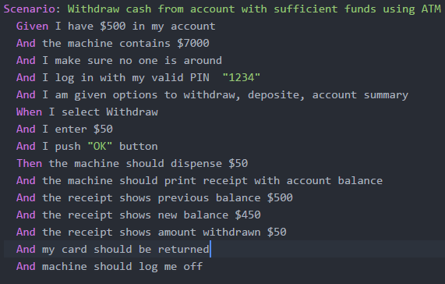
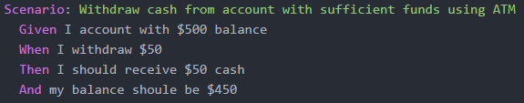
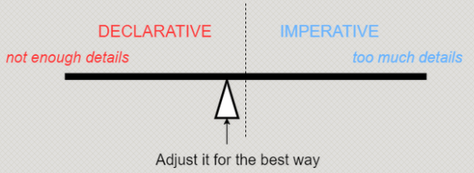
Gherkin - Declarative vs Imperative

Slide 17
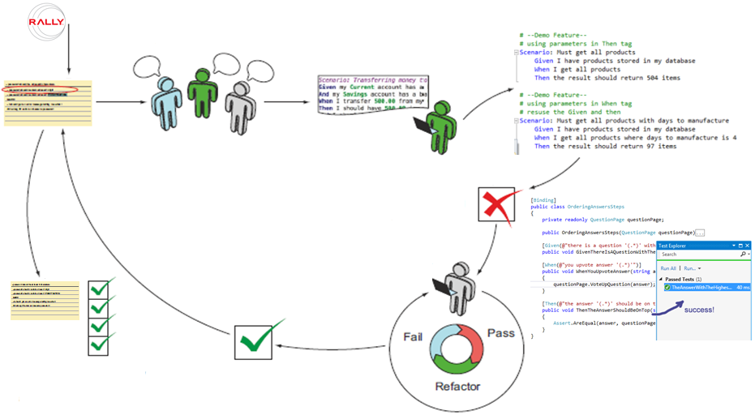
ATDD – High level process
2) Team conversation about story and acceptance criteria
4) Write Executable Scenario -SbE
1) User story
3) Write scenarios
5) Implement the Scenario
8) User story is accepted the when all scenario automated and passed
7) You are done with the scenario when the automated scenario passes
6) TDD - Unit test drive the development

Slide 18
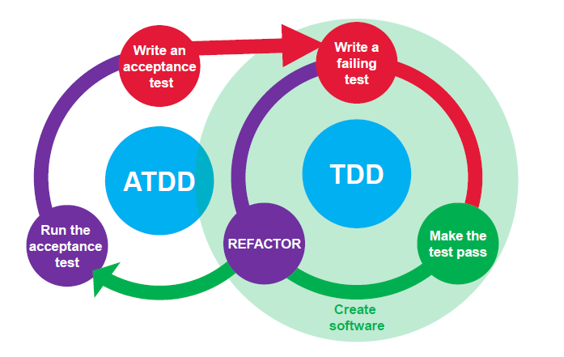
Red-Green-Refactor

Slide 19
Technology and Tools
Technology/ languages | Framework/Tools
Java / JVM languages (Groovy, scala) | Cucumber-JVM Spock
C# and .Net | SpecFlow (.Net implementation of cucumber)
JavaScript | Cucumber.js Jasmine, Mocha
Ruby | Cucumber
Python | Behave, radish

Slide 20












Slide 21
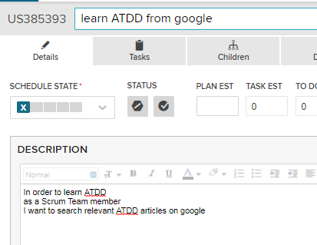
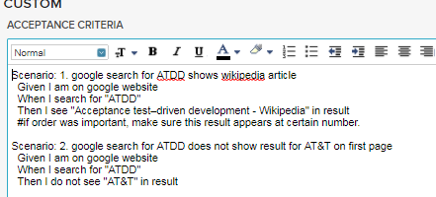
User story in CA Agile central/ Rally
Acceptance criteria are captured in Gherkin in Rally.

Slide 22
Traditional versus Gherkin
User Story:
Management Approval of Employees Requests
As a Department Manager
I want to approve my employees requests for installing a new software from AppStore
So that they can proceed with installation.
Acceptance Criteria:
Verify that:
1. I can see all approval requests on “Approvals” page for all my direct reports
2. I can click on the approval link to approve the request
3. The employee will receive an email “Your Request # {xxxxx} has been approved”
Gherkin Feature File:
Management Approval of Employees Requests
In order to support employees in installing new software on their workstations
As a department manager
I want to approve employees requests to install new software from AppStore
Acceptance Criteria:
Scenario: View and Approve Employees Requests to Install New Software
Given employee1 submitted 2 requests
And employee2 submitted 2 requests
And employee3 submitted 1 requests
And Tom P logged in as development manager
When I go to the AppStore Approvals page
Then I see 5 pending approvals for my 3 employees
When I click on the approval link to approve the request
Then I see approval status updated for the requests
And the employee received an email “Your Request # {xxxxx} has been approved”
[note: These could be separated into different scenarios]
Makes you think about examples, and test data!
Encourages collaboration

Slide 23
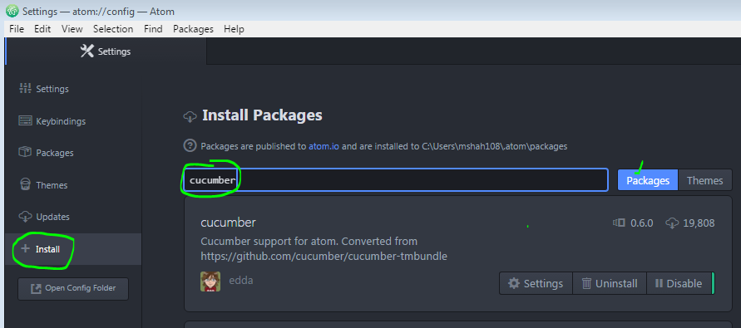
Atom Editor
Useful for business writing Gherkin (PO/BA/SA), who do not have IDE
Install Atom from AppStore
Install cucumber plugin-- File > Settings > +Install > search “cucumber” packages (may take some time) > install, may need restart.

Slide 24
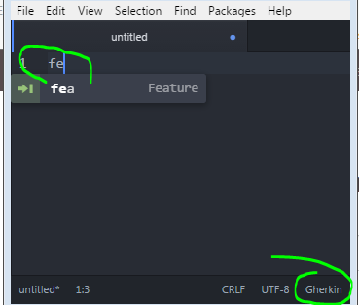
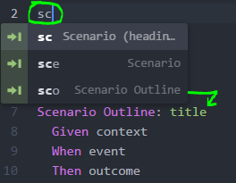
Atom Editor – with cucumber plugin
Provides templates by typing few keywords
Highlights Gherkin keywords
Separate cucumber-autocomplete plugin provides suggestions from previously defined steps

Slide 25
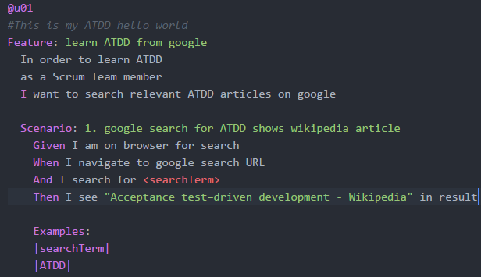
Atom Editor - Example
Provides templates by typing few keywords
Highlights Gherkin keywords

Slide 26

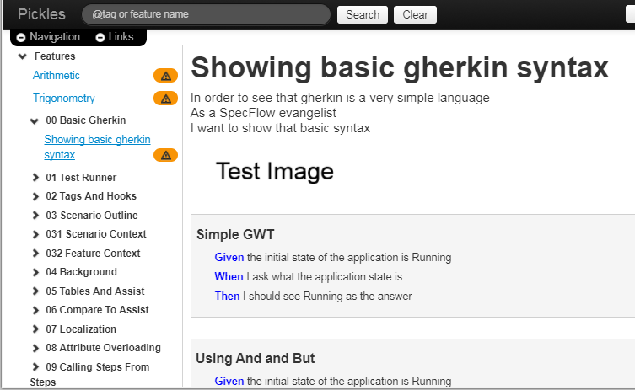
Pickles
Generates documentation and searchable repository out of feature files
Produces different format, for html/dhtml you need application server
Useful for team, especially for business
search
Features
Scenario displayed
based on browse/search

Slide 27
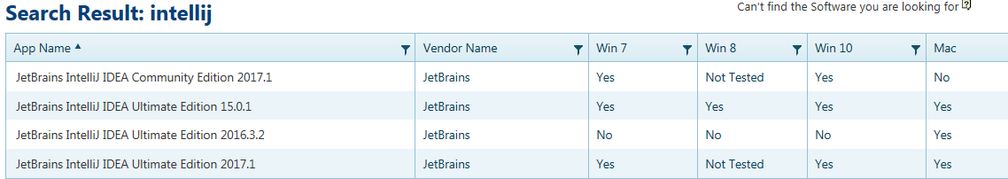
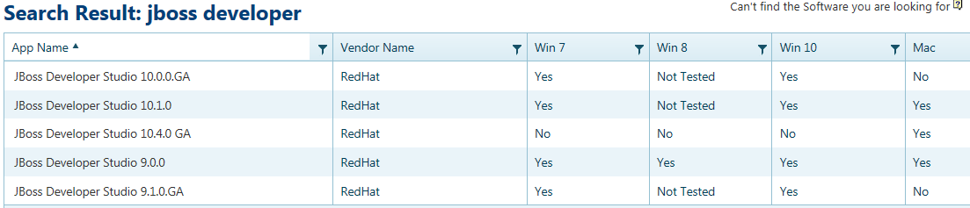
IDE – install and setup
Install IntelliJ/ Jboss

Slide 28
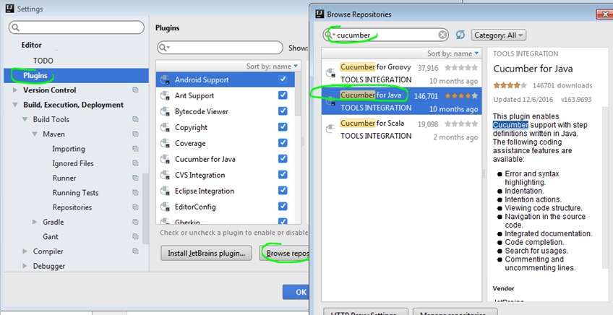
IDE – IntelliJ – Cucumber plugin
Install Cucumber Java plugin-- File > Settings> Browse repo…> search “cucumber for java” > install, will restart IntelliJ restart.

Slide 29
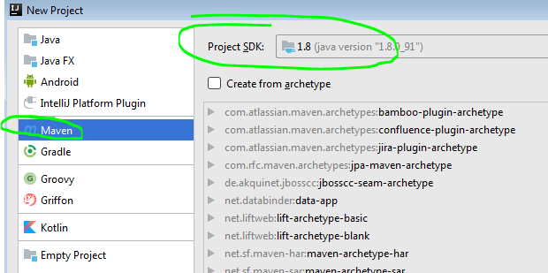
IDE – maven and jdk
Create new project/ open existing as java maven project and use appropriate JDK

Slide 30
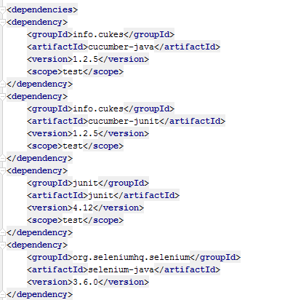
Maven POM
In order to make use of Cucumber-JVM in a Maven project
To facilitate JUnit testing with Cucumber
Use selenium

Slide 31
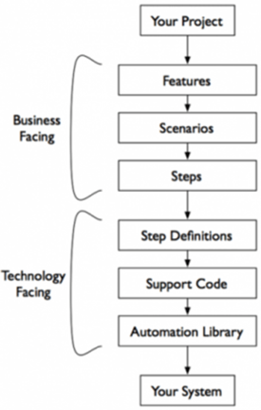
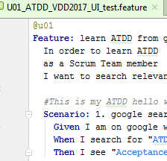
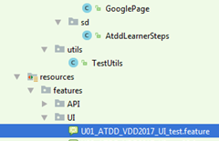
Cucumber structure
Feature file
Glue code
Page Objects,
Utilities

Slide 32
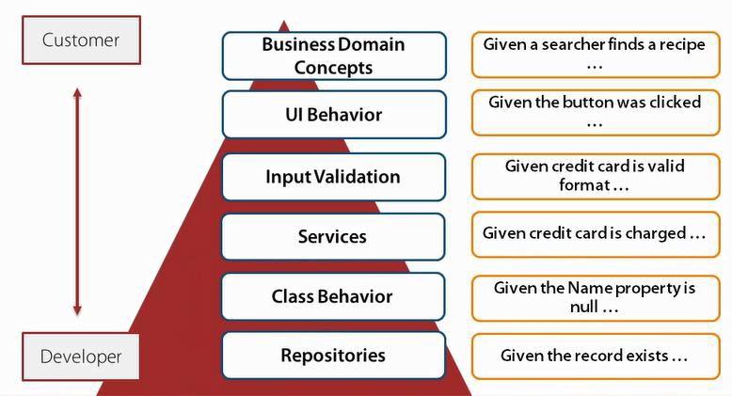
Scenarios – at different levels

Slide 33
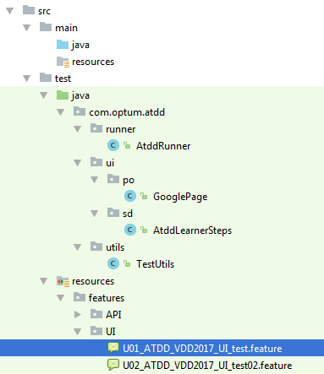
Structure
Page Objects
Step Definition/
Glue code
Feature file – name links to User story
(can be further organized
by sub-folders
of application features)

Slide 34
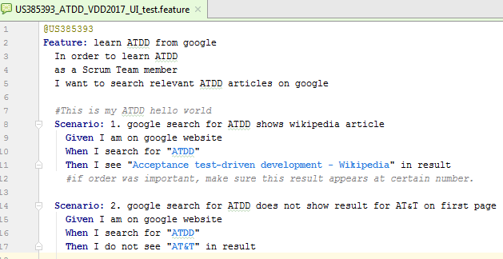
Feature file, Scenario, Step
Feature in cucumber feature file
Normally corresponds with user story in Rally
Scenarios:
few scenarios per feature file
positive, negative, edge cases
Meaningful and short title
Steps:
few steps per scenario
Meaningful and short
Easy to understand by all
Comments:
Enhances understanding
E.g. capture inherent step

Slide 35
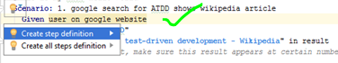
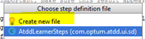
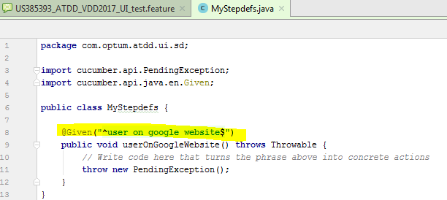
Create step definition
IDE helps creating step definitions (press Alt + Enter on undefined step)
Use of regular expression
to match step in feature file
Ctrl + B on a step in feature file, takes you to corresponding step definition

Slide 36
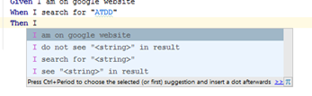
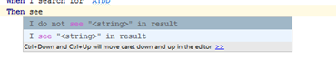
IDE – step suggestions
In IDE feature file as you type to write step,
matching steps from the defined step definitions are displayed for selection.

Slide 37
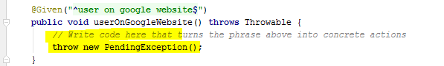
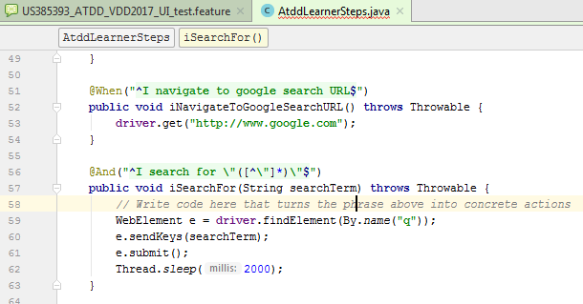
Step definition
Initially empty implementation
is replaced by actual
test code for the step

Slide 38
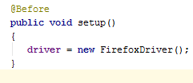
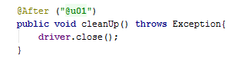
Hooks
Hook runs before
every scenario
Hook runs after
“u01” tagged scenario
@Before hook... examples
Starting a webdriver
Setting up DB connections
Setting up test data
Setting up browser cookies
Navigating to certain page
@After hook… examples
Killing the webdriver
Closing DB connections
Clearing the test data
Clearing browser cookies
Logging out from the application
Printing reports or logs
Taking screenshots on error

Slide 39
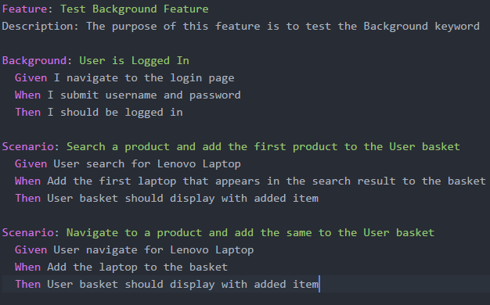
Background
Background can be used to capture common steps in all scenarios of a given feature file
Background runs before every scenario
Keep background short

Slide 40
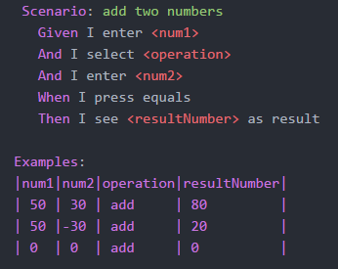
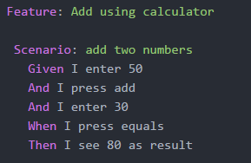
Scenario Outline
Cucumber supports data driven testing
Identify key steps of your scenario
Identify place-holders and corresponding data that you need to test with
Execution happens with each data row, like it is a separate scenario

Slide 41
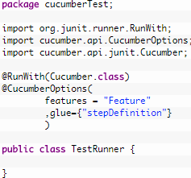
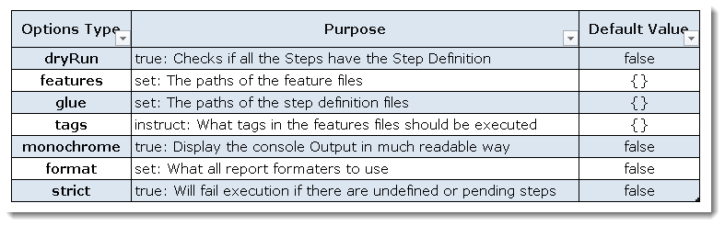
Runner class – cucumber options
Cucumber uses Junit , a runner class will tell Junit which test runner class to use.
@RunWith annotation tells JUnit that tests should run using Cucumber class present in ‘Cucumber.api.junit‘ package.
@CucumberOptions has settings for test, which enables options similar to command line
Limit execution using various combinations of tags

Slide 42
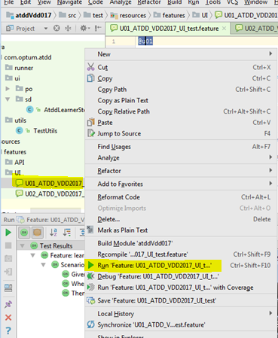
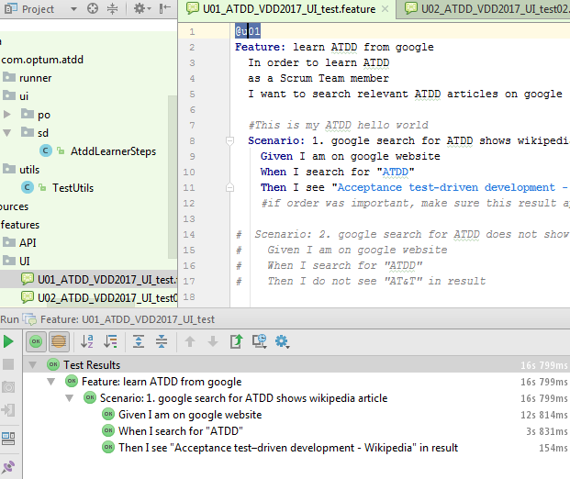
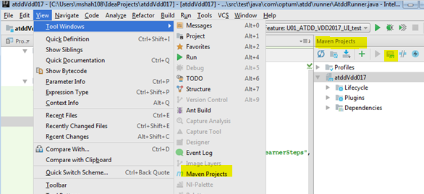
Execution
Run using feature file, or runner class, or maven goal
Test execution results
To bring maven toolbar
and execute maven goal

Slide 43
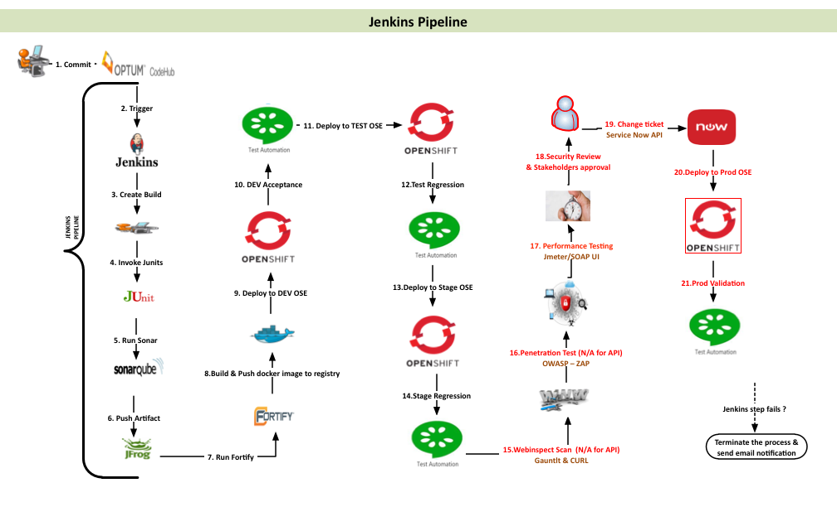
Jenkins pipeline

Slide 44
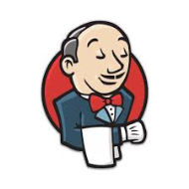


Test execution
In-house
Begin Tests
Servers /
Devices
APIs
Test Runner / Config
Cucumber / Step Definitions
UI/API
Feature Files
Run Tests
User Stories
Java Code / Libraries (Selenium, LeanFT, Appium)
Test Results

Slide 45
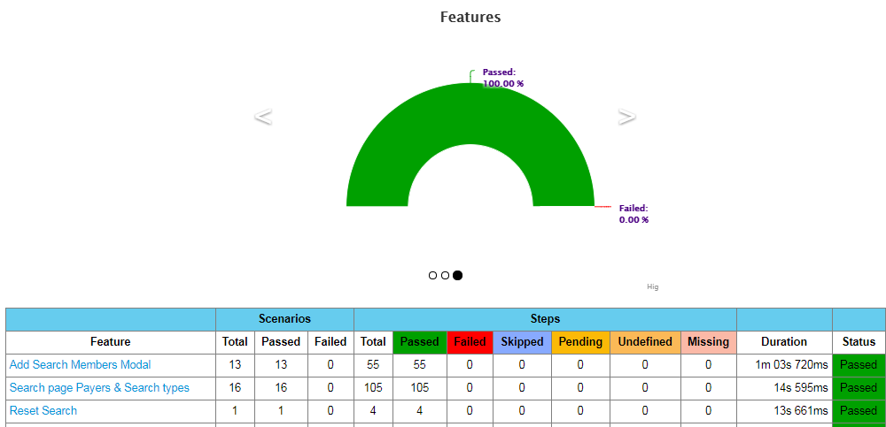
Cucumber test report

Slide 46
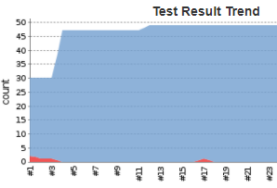
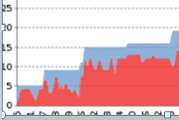


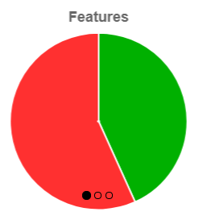



Report and trend

Slide 47
Tags
Tags allows a way to group / reuse your scenarios and feature files for execution.
Traceability -- @Rnn.nn @PI11.1 @F01189 @US087234 -- Release/ Program increment/ sprint/ feature/ user story
Identifying state of work -- @wip, @tmp -- Work in progress, temporary
Size or speed -- @small @mid @large @fast @slow @sluggish
Frequency of execution -- @check-in @daily @weekly
Event based -- @DevBuild @everybuild
Environment specific, Type of test -- @smoke @int @bvt @stage @regression
Identifying scenario type -- @positive @negative @edgecases @invasive @destructive
Functionality -- @Login @Search @ProcessClaim
Note: Tags are inherited at different level below, so do not repeat at sub-level
e.g. use for Feature, Scenario, Scenario Outline or Examples

Slide 48


Report with tags

Slide 49
OCM ATDD Implementation

Slide 50

OCM ATDD - Project structure
Utils
Globals - constants for application
SeleniumUtils - browser and platform configs
TestUtils - base selenium actions
DAO
Database connectivity
Data access methods
Resources
Feature files
Config-files for connections, browsers, user info
Mocked test data in excel/ datasheet
Page Objects
Step Definitions

Slide 51

Feature file
Feature files are based on Rally acceptance criteria
Contains positive, negative and edge cases
Tagged with different tags for tracking, identifying functionality, dependencies etc.

Slide 52


Step definition
Step definitions are further grouped into step definition classes according to page objects
Step definition class extend test base class. Test base class contains objects created for all page classes, so step definition have access.

Slide 53


Page Object
Page class corresponds to web page, which contains:
locators – css selector and Xpath
action methods
validation methods

Slide 54




Hooks
Hooks can be used for Before and After execution of every scenario.
You can limit execution of hooks to certain scenarios by tag in annotation

Slide 55



Parallel Execution
Tagging feature file with particular tag for acceptance, common for all accepted feature file
Dynamically generating runner classes per feature file
Each runner class will execute in parallel (Sauce Labs), and generate JSON report file
Report files are fed into cucumber-jvm plugin, to generate final HTML report

Slide 56

Sauce Labs
Job name in Sauce Labs are based on feature/user story name
Cross browser, cross platform and mobile testing
Recording and live test executions are available, which helps in debugging
Use of specific screen resolutions and time zones
Using ~70 concurrent sessions

Slide 57



Rally - Test cases and status update
Rally test cases are created from scenarios in feature file
Rally test case IDs are updated in scenario title (TC283037)
Rally is updated automatically from test execution for latest pass/fail result

Slide 58




ATDD, TDD and CI
Scrum Team
Check in
Unit Tests + Code
Change Detected
Gherkin with SbE
(User Stories and
Acceptance Criteria)
DEV
Check in
Acceptance Tests
Continuous Integration (Jenkins)
QA/SDET
Test results /
Build Dashboard
Test Execution
Updates to Rally

Slide 59
Developing best practice…
DOR and DOD updated to support ATDD
Consistency across multiple teams in your application/program
Feature file naming and organization
Use of tags (functional areas, environment, smoke-test… Regression)
Reusability
Red-Green-Refactor
Test continuously
Make scenarios independent, and use of parallelization
Collect metrics
Fix failures, maintain it
Automation = Coding… all practices for coding can apply !!

Slide 60
Testimonial
Some aspects from A4Me ATDD implementation success story
 | No ATDD | With ATDD
UAT | 3-12 weeks | In sprint
Defect Detection | 5-60 days | < 2 days
Regression | Weeks | Minutes/ hours
Refactor risk | High | Low

Slide 61

Resources
Internal
OSAM Communities/ DevOps: https://hubconnect.uhg.com/groups/osam-continuous-delivery-quality
Test automation and SDET: https://hubconnect.uhg.com/groups/4981
Test transformation CoE: https://hubconnect.uhg.com/groups/test-transformation-coe
Synergy: http://wiki.optum.com/display/OTSTC/Synergy
Learn source - Acceptance Test Driven Development
*For coaching help contact Magnus Hedemark
External
https://dannorth.net/introducing-bdd/
https://dannorth.net/whats-in-a-story/
https://github.com/cucumber/cucumber/wiki
https://cucumber.io/
http://docs.behat.org/en/v2.5/guides/1.gherkin.html
https://www.thoughtworks.com/insights/blog/specification-example
https://blog.engineyard.com/2009/15-expert-tips-for-using-cucumber
http://toolsqa.com/cucumber/

Slide 62
Questions
& Answers

Slide 63


